Slide 1


Name:SANTOSH BISWAL
REGISTRATION NO.2305260021
4TH SEMISTER

Slide 2
content
1.Objective
2.Key Features
3.System Requirement
4.Tools and Technology
5.ER Diagram
6.benfits
7.Screenshot of TECH-TEKKER
8.Future Enhancements
9.Challenges and solution
10.Security features
11.Conclusion

Slide 3
Introduction to TECH TREKKER
TECH TREKKER is based on a type of website or online platform where individuals, groups, or organizations share content in a regularly updated format. Originally, blogs were like online diaries or journals, but over time they have evolved into diverse platforms for sharing opinions, insights, expertise, and creative content.

Slide 4
Object of the PROJECT
Share Information or Insights: Many blogs are created to educate or inform readers about specific topics, such as health, technology, fashion, or travel. The objective is to provide valuable content that helps readers learn something new or stay updated on particular subjects.
Personal Expression: Some blogs are more about personal expression, where the blogger shares thoughts, experiences, and opinions. This type of blog can serve as a creative outlet and a way for individuals to communicate their perspectives on various issues or their life experiences.

Slide 5
Key features
Posts/Articles: The main content of a blog is typically presented in the form of posts or articles. These are often displayed in reverse chronological order (with the latest post at the top) and are usually categorized by topics or tags
Comments Section: Most blogs allow readers to leave comments on posts. This feature fosters interaction and engagement between the blogger and the audience, creating a sense of community.

Slide 6
SYSTEM REQUIREMENTS
Hardware Requirements
Display: 1920x1080 resolution Monitor.
Processor: Intel Core i5 or higher.
Network: Internet connectivity or Wi-Fi.
Storage: At least 256GB SSD.
RAM: 8GB or higher.

Slide 7
Software Requirements
Visual Studio Code.
Git
My SQL
XAMPP

Slide 8
TOOLS AND TECHNOLOGY
Graphical User Interface will be the preferred front-end interface to information display, since easy to use even for inexperienced users, it is attractive, provide shortcuts, and allows room for multitasking.
HTML
Hyper Text Mark-up Language is used for developing front-end Graphical user interface. It is standard language used for web pages.
CSS
Cascading style sheets are a style sheet language used to show a document or content written in mark-up language.
SPRING BOOT
Spring Boot is a Java framework that makes it easier to create and run Java applications. It simplifies the configuration and setup process, allowing developers to focus more on writing code for their applications.

Slide 9
.
JAVA
Java is a class-based, object-oriented programming language that is designed to have as few implementation dependencies as possible. It is intended to let application developers Write Once and Run Anywhere (WORA), meaning that compiled Java code can run on all platforms that support Java without the need for recompilation.
MYSQL
For database MYSQL is used. This technology will ensure that the software is scalable, reliable, and secure.

Slide 10
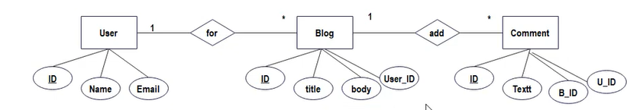
ER Diagram

Slide 11
Benefits
Establish Expertise: By consistently writing high-quality content on a particular subject, bloggers can position themselves as experts in that field. This can enhance their credibility and reputation.
Direct Audience Interaction: Through comments, emails, and social media, bloggers can directly interact with their audience, fostering a deeper sense of connection.
Brand Partnerships: Successful blogs can attract brands or companies interested in collaborating for paid content, product reviews, or sponsored posts.

Slide 12
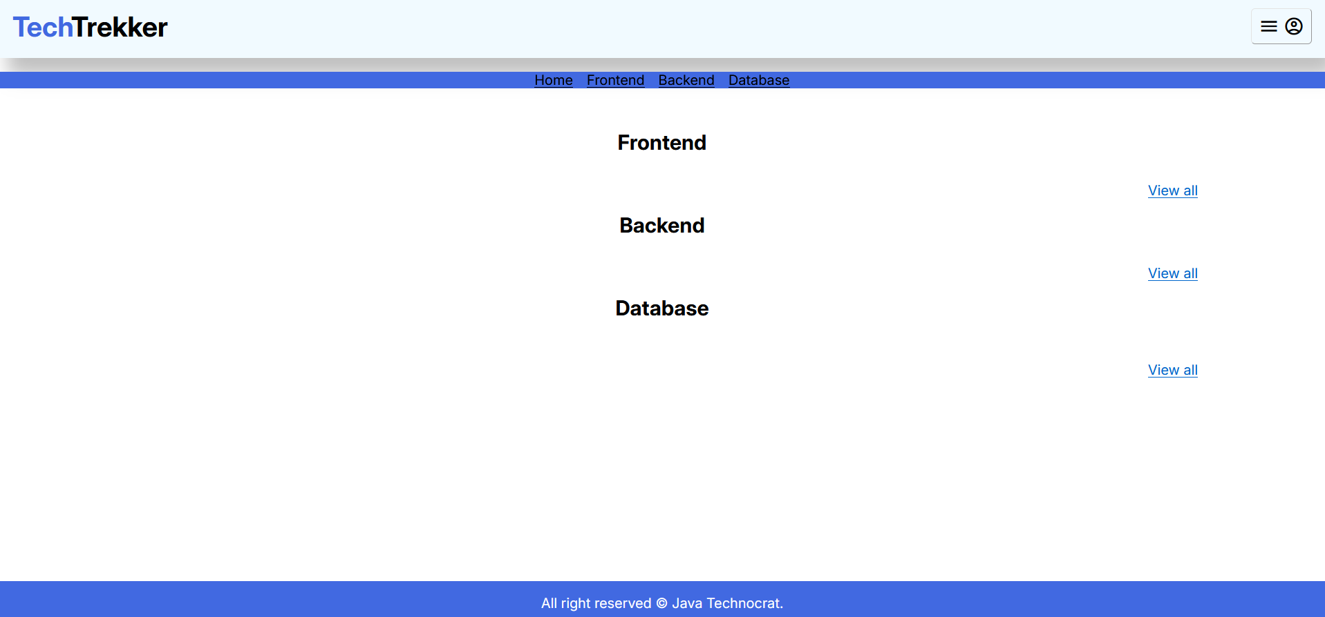
Landing Page

Slide 13
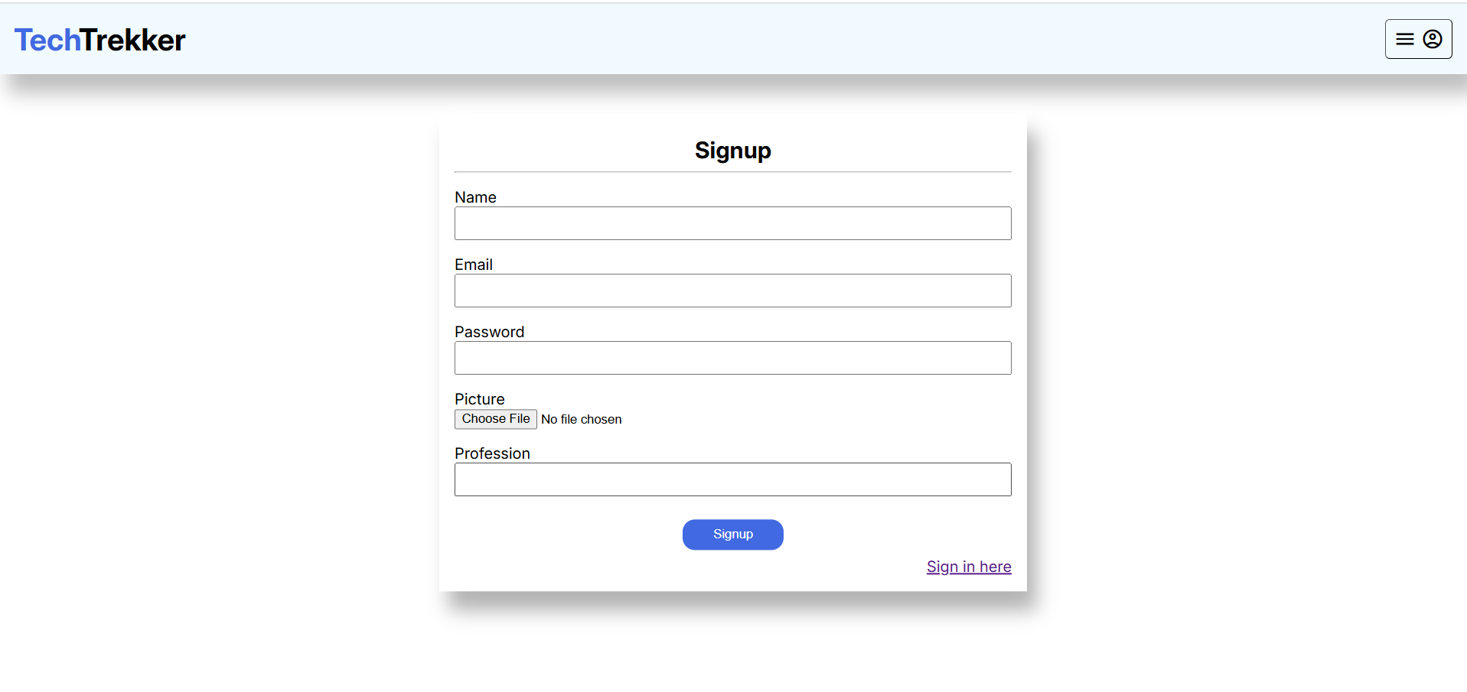
Singup Page

Slide 14
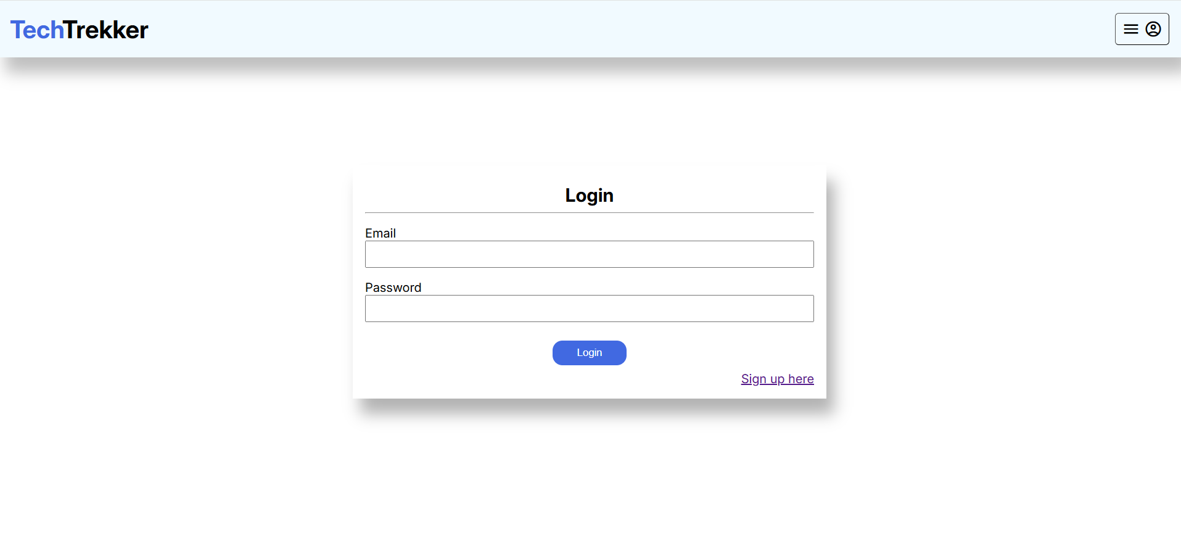
Log in Page

Slide 15
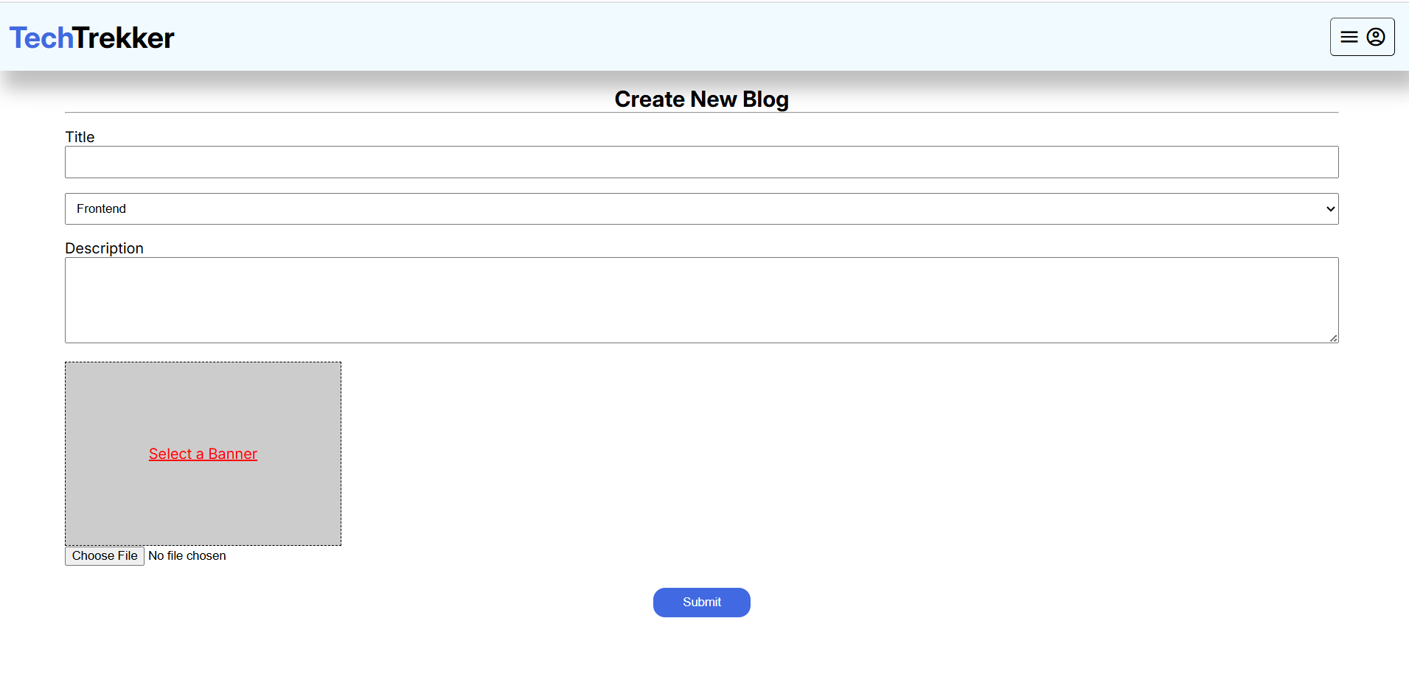
Create Blog Page

Slide 16
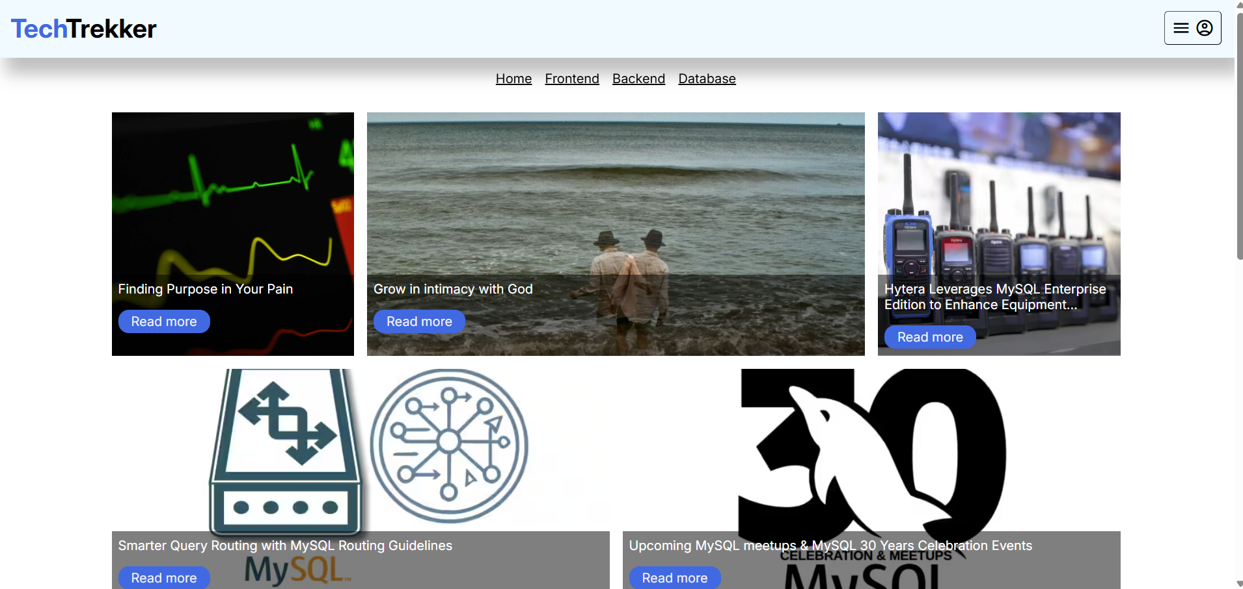
Home Page

Slide 17
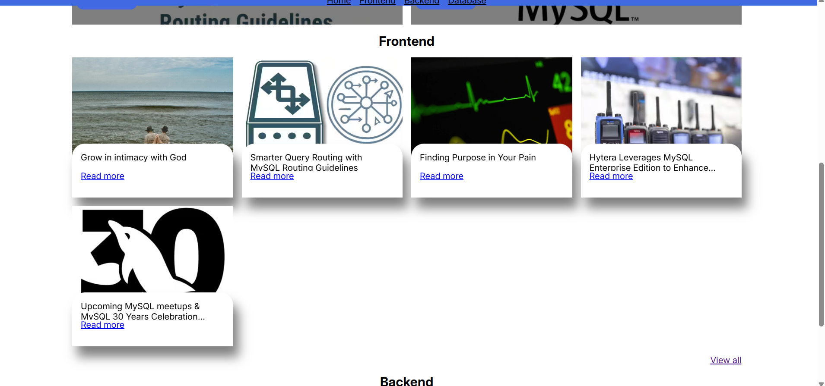
Fronted Page

Slide 18
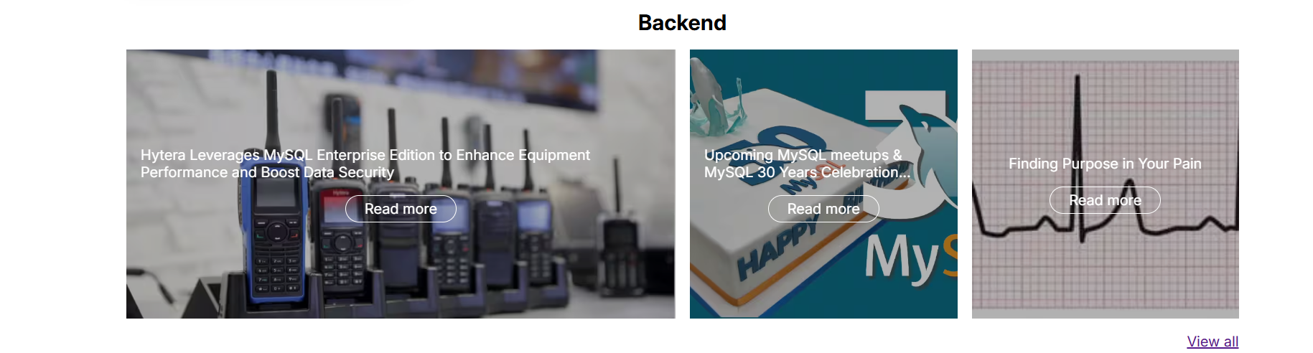
Backend Page

Slide 19
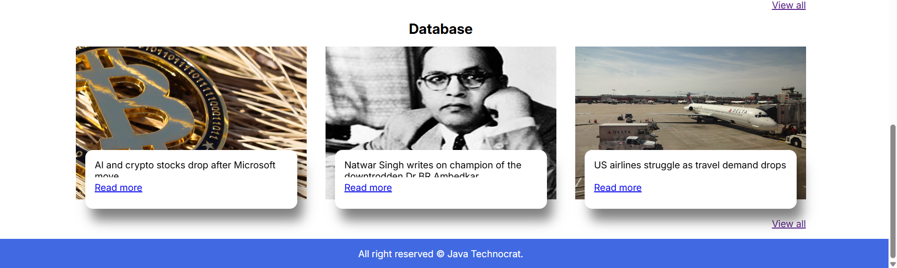
Database Page

Slide 20
Future Enhancement
Enhanced Visual Content
AI-generated images and videos: Bloggers could use AI tools like DALL·E or other image-generation tools to create unique images and illustrations that complement their posts.
Interactive Media: Augmented Reality (AR) or Virtual Reality (VR) could be incorporated into blogs to offer immersive experiences related to the blog's content.
Content Personalization
User-customized blogs: Readers could personalize the blog’s layout and content based on their preferences. The blog could adapt to reflect content types (video, articles, podcasts) that a user enjoys most.
Dynamic content: Blogs that change or update in real-time based on trends, seasonal topics, or even reader actions.

Slide 21
Challenges and Solution
Challenge: Content Creation Consistency
Solution:
Create a Content Calendar: Plan your blog posts ahead of time. This ensures that you stay consistent and don’t run out of ideas.
Batch Content Creation: Set aside specific time blocks to write several posts at once. This gives you a buffer and ensures you always have fresh content.
Repurpose Content: Turn old posts into new forms—like turning a blog post into a video or infographic—to maintain regular updates without starting from scratch.
Challenge: Gaining Traffic and Audience Growth
Solution:
Leverage Social Media: Promote your posts on social media platforms, such as Twitter, Facebook, Instagram, or LinkedIn, to reach a broader audience.
Collaborate with Others: Guest posting, collaborations, and sharing links with other bloggers in your niche can increase exposure.
Optimize for Email Marketing: Build an email list and send regular newsletters to keep your audience engaged and bring them back to your blog.

Slide 22
Security Features
1. Strong Password Protection
Secure Passwords: Use long, complex passwords with a mix of uppercase letters, numbers, and special characters.
Password Manager: Encourage using a password manager to store and generate secure passwords for your blog and associated accounts.
Password Policies: Implement policies for changing passwords periodically and avoid using the same password across different accounts.
2. Two-Factor Authentication (2FA)
Enable 2FA: Adding a second layer of security, like a code sent to your phone or email, ensures only authorized users can access your blog’s admin panel, even if they know the password.

Slide 23
Conclusion
A blog is a powerful platform for sharing knowledge, building a community, and creating a personal or business brand. However, to make it successful, it's essential to consider various elements, from content creation and SEO optimization to security and user management. By implementing good practices, choosing the right user roles, and ensuring the security of your blog, you can provide a safe and engaging space for your audience.

Slide 24


